Slide 1

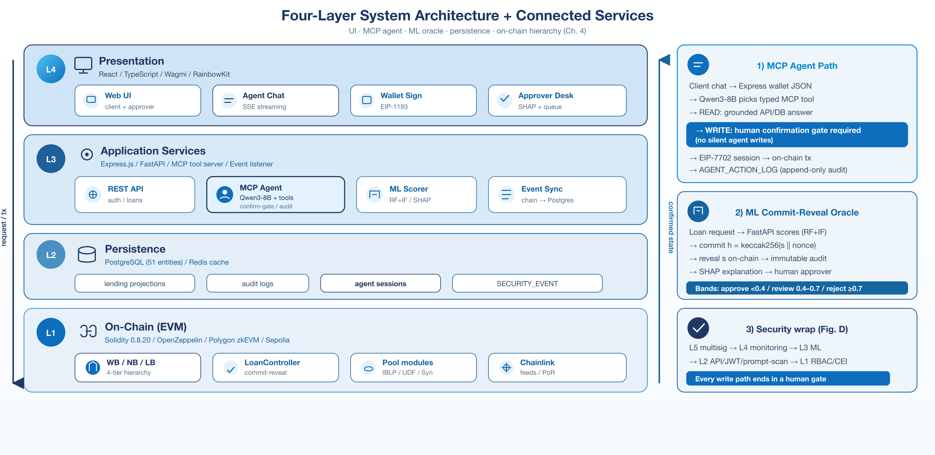
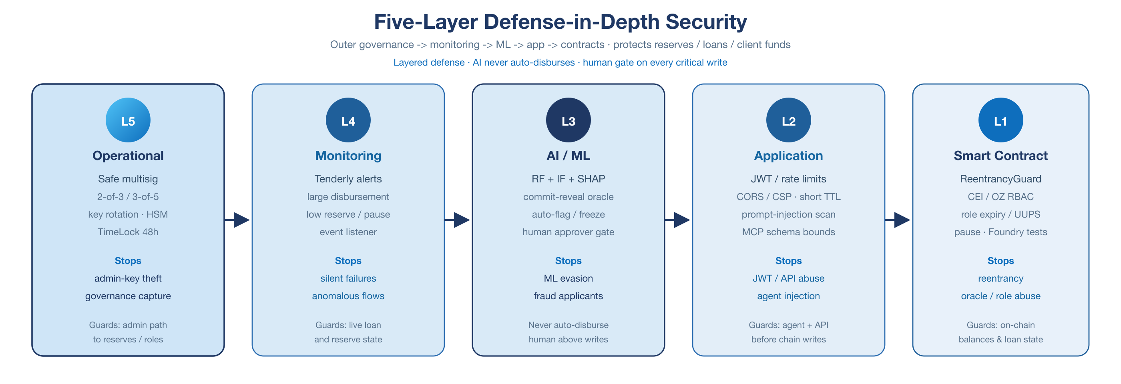
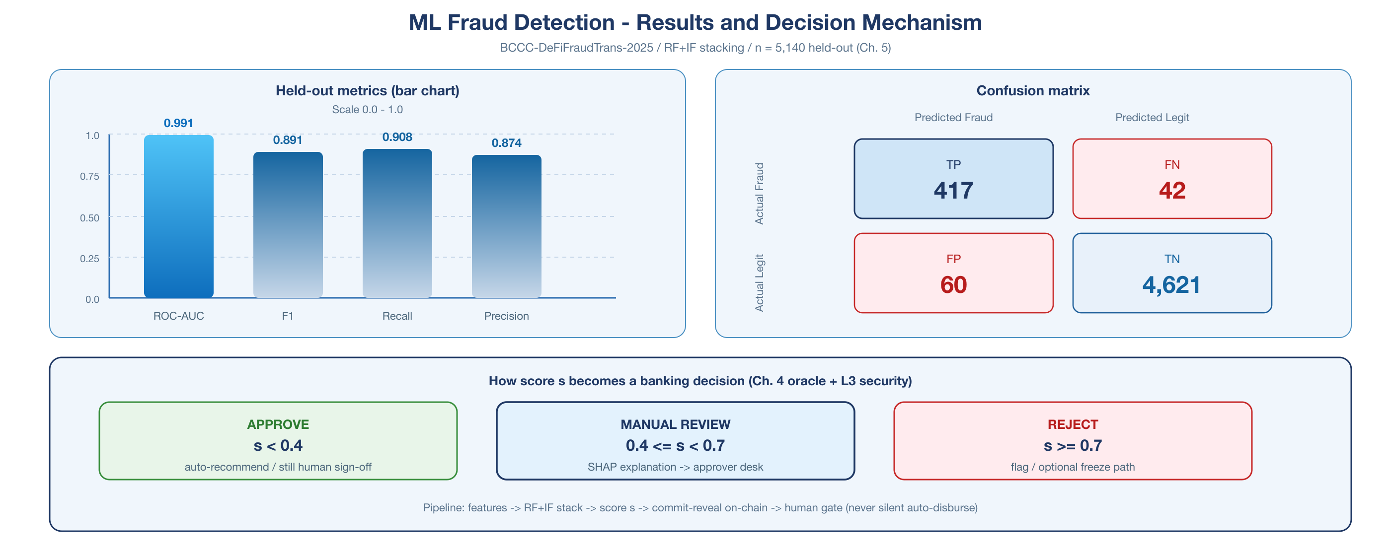
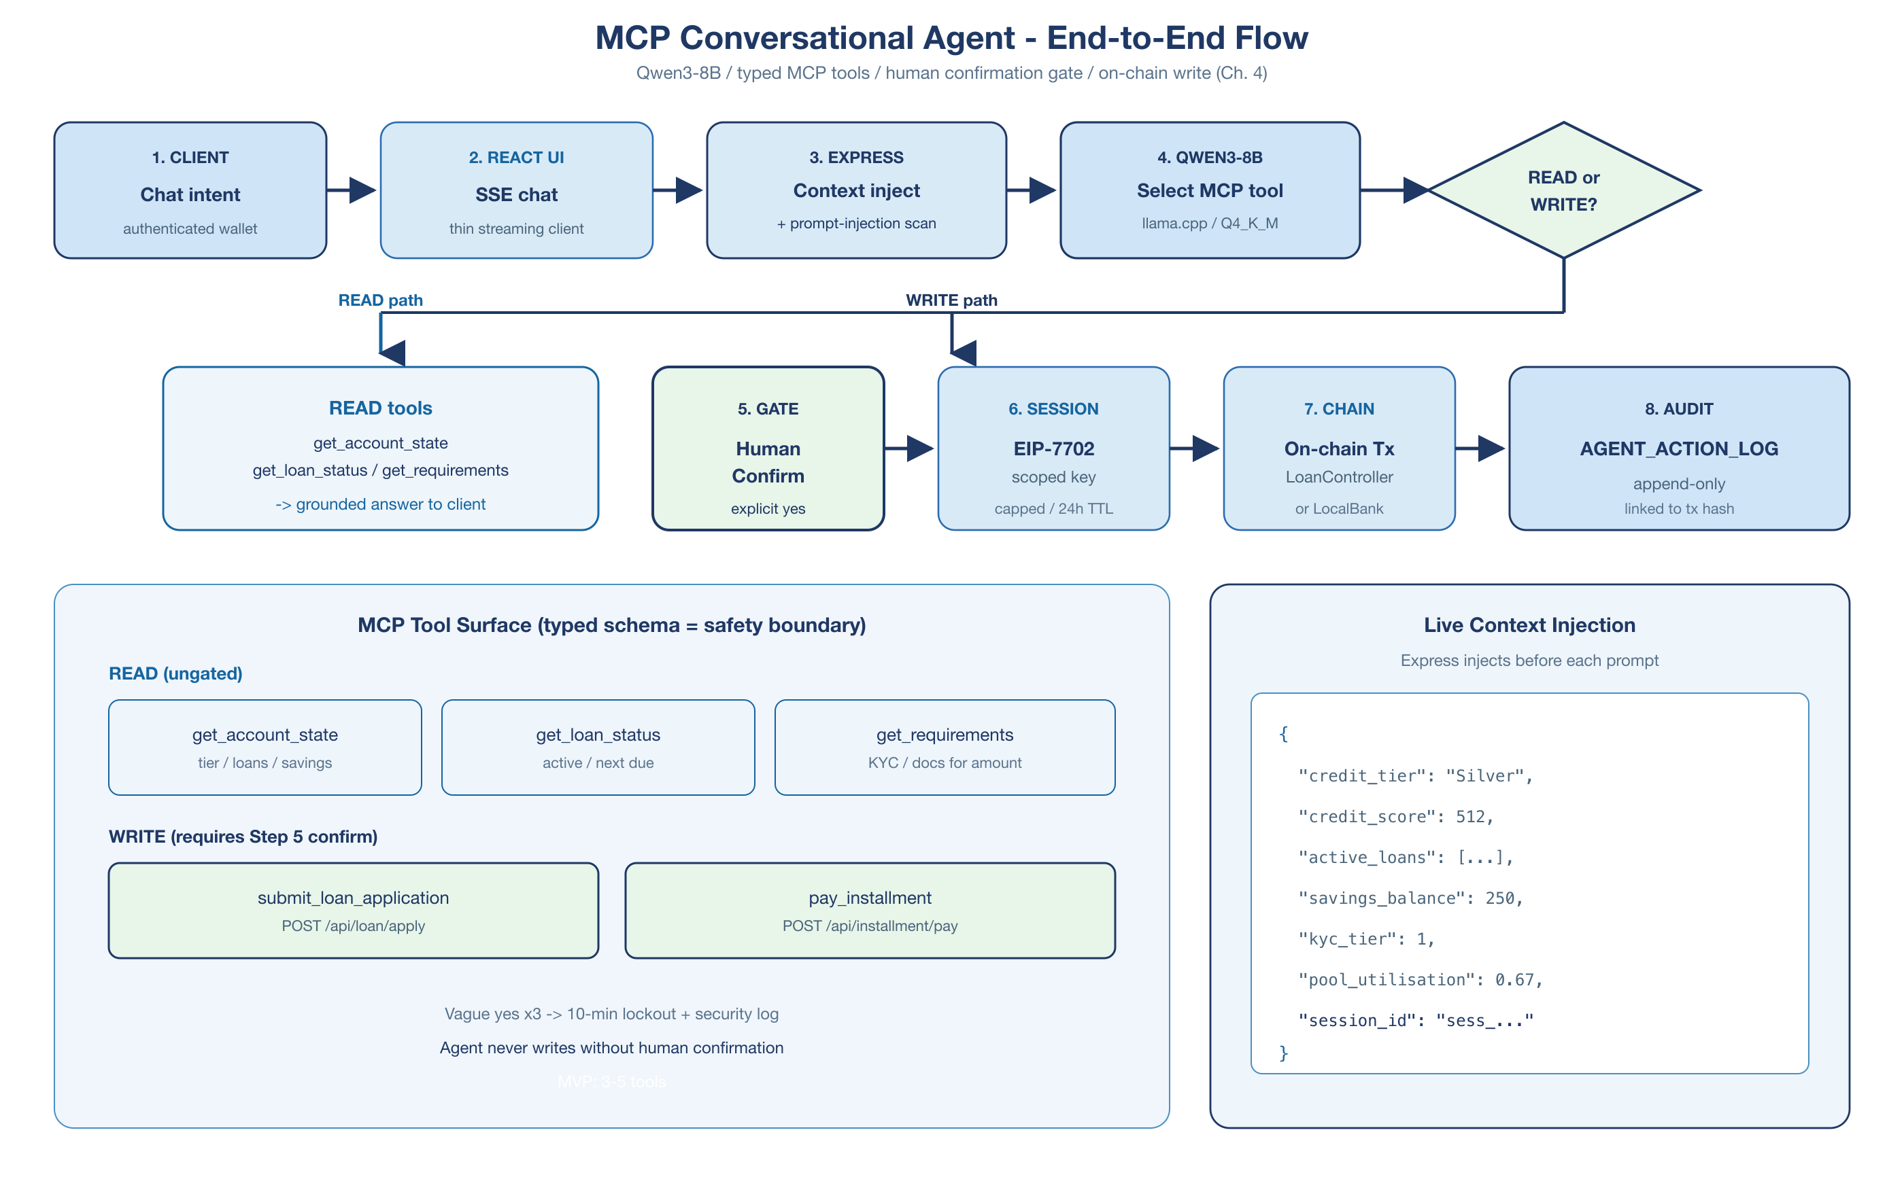
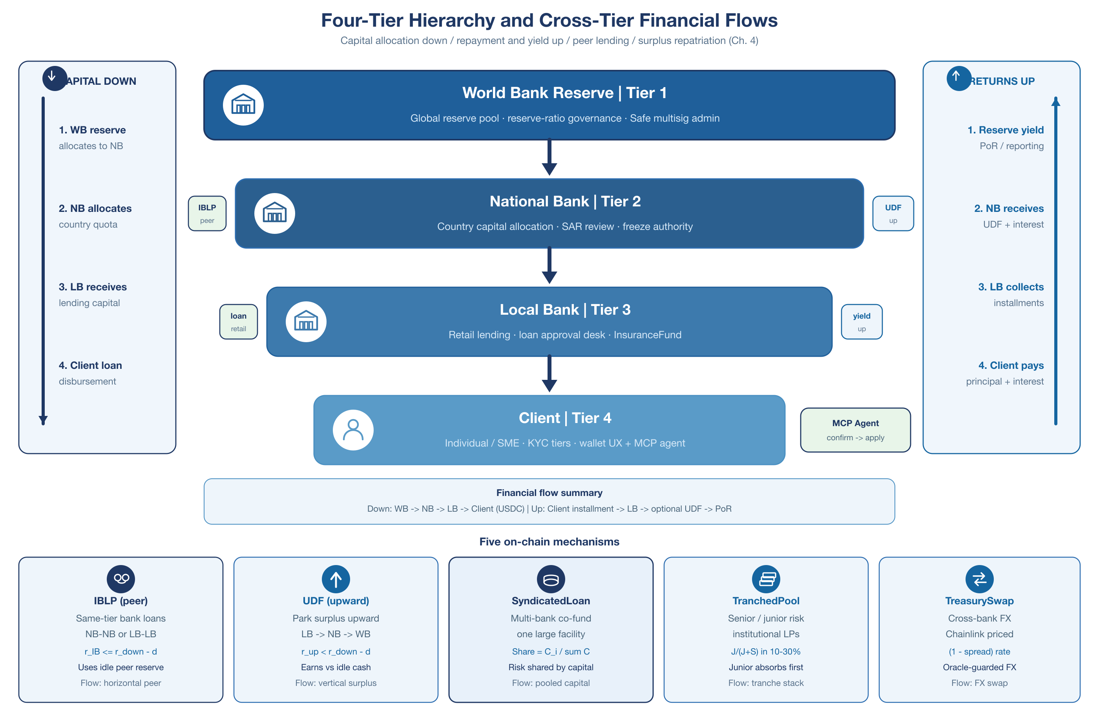
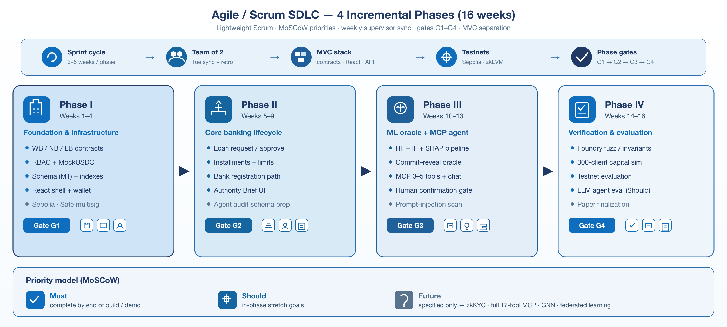
Decentralized Crypto World Bank
A Blockchain-Based Banking Platform with AI-Enhanced Security and Assistance
BRAC University Department of Computer Science and Engineering
Md. Bokhtiar Rahman Juboraz (20301138) | Md. Mahir Ahnaf Ahmed (20301083)
Supervisor: Mr. Annajiat Alim Rasel, Senior Lecturer, Dept. of CSE, BRAC University
Abstract
System Architecture
Five-Layer Defense-in-Depth
Modern institutional banking is organized in restrictive layers that limit equal access to financing. Crypto World Bank (CWB) specifies a four-tier, hierarchically-governed DeFi platform — World Bank reserve → National → Local Banks → Clients — mirroring real-world development finance while enforcing reserves, credit allocation, and risk analytics on-chain. Six on-chain banking functions (deposits, credit allocation, settlement, risk intermediation, liquidity management, ancillary services) sit behind a five-layer defense-in-depth security model. AI-driven fraud detection (Random Forest + Isolation Forest, F1 = 0.891) and an optional MCP-based conversational agent enhance security and usability, showing a transparent, open-source alternative to flat DeFi lending is achievable.
Introduction
1.1 Background
World→National→Local→Client layers face settlement friction, opaque reserves, idle correspondent capital; flat DeFi ignores this hierarchy.
1.2 Rationale
Encode hierarchy on a programmable ledger—reserves, RBAC, auditable flows—supporting human credit judgment.
1.3 Problem
Six gaps: low transparency; slow/costly settlement (~$45, 2–5 days); inconsistent risk; high audit cost; no programmable savings/group credit.
1.4 Objectives
4-tier EVM lending + banking suite, off-chain ML risk analytics, optional agent; deploy/evaluate on testnets.
1.5 Solution
On-chain WB→NB→LB→Client model covering deposit, credit, settlement, risk, liquidity, and ancillary services.
1.6 Contributions
Novel 4-tier+AI/ML; five multi-entity mechanisms; commit–reveal ML oracle; 5-layer defense; optional MCP agent (Qwen3-8B).
Result Analysis
Dataset: BCCC-DeFiFraudTrans-2025 (York Univ.), 50,000-txn subsample, 8.65% fraud rate, 21 features. Model: Random Forest (80 trees) + Isolation Forest (80 trees) + logistic stacking.
MCP Agent Pipeline
Conversational agent with confirm-gated writes and append-only audit
System Requirements Analysis
Full FR/NFR sets are specified in the report; representative items below.
Type | ID | Description
Functional | FR-01 | Four-tier hierarchy: World→National→Local→Client, role-gated capital allocation
Functional | FR-02 | Loan lifecycle: request → ML score → approval → disbursement → repayment
Non-Functional | NFR-01 | Performance: ML inference ≤50ms; API p95 ≤500ms
Non-Functional | NFR-02 | Security: RBAC, ReentrancyGuard, human approver gate
Functional | FR-03 | Multi-entity ops: InterBankLendingPool, UpwardDepositFacility, SyndicatedLoan, TranchedPool, TreasurySwap
Conclusion
➤ First specification combining a 4-tier institutional hierarchy with DeFi and AI/ML risk analytics — not previously demonstrated in the literature.
➤ Shows a programmable lending platform can improve transparency and security across World→National→Local→Client capital flows.
➤ Core DeFi stack follows conventional design; the 4-tier + AI/ML integration is the project's original contribution.
➤ Economically viable at prototype scale: NPV ≈ $149.7k and positive ROI over a 3-year horizon at 10% discount rate (Section 5.4).
Future Work
➤ Deploy on Polygon zkEVM Cardona; live reserve-transparency dashboard & multisig admin.
➤ Expand interbank pools, group lending, upward deposits; zkKYC/zkAML, Certora proofs, federated learning.
➤ Formal verification (Certora), GraphSAGE graph-ML fraud scoring, and Chainlink Functions/Automation/PoR for production-grade oracle upgrades.
Fig. MCP agent path (confirm-gated writes)
Four-Tier Hierarchy & Cross-Tier Mechanisms
Methodology
Agile/Scrum across 4 phases (3–5 weeks each, 16 weeks); team of 2; weekly supervisor sync.
➤ Stack: Solidity · React · Express.js/FastAPI · PostgreSQL · scikit-learn
➤ Testnets: Ethereum Sepolia & Polygon zkEVM Cardona · MVC (contracts/React/Express)
➤ Security: 5-layer defense — contract guards → API → ML screening → monitoring → multisig
References
[1] S.M. Werner et al. SoK: Decentralized Finance (DeFi). arXiv:2101.08778, 2022.
[9] World Bank. The Global Findex Database 2021.
[13] IFC. MSME Finance Gap. World Bank, 2017.
[18] DefiLlama. Aave V3 TVL, Fees, Revenue & Income Statement, 2026.
[99] BCCC, York University. BCCC-DeFiFraudTrans-2025, 2025.
[15] CPMI & BIS. Correspondent Banking — Technical Report. BIS CPMI Papers No. 147, 2016.
[17] World Bank. Remittance Prices Worldwide. Migration & Development Brief 40, 2024.
[21] Fensory. Maple Finance — Institutional DeFi Lending Protocol, 2026.
[25] World Bank. World Bank Group Tracks Project Funds with New Blockchain Tool (FundsChain), 2025.
[26] JPMorgan. Kinexys Digital Payments: Real-Time Multicurrency Payments, 2025.

